Slide 1
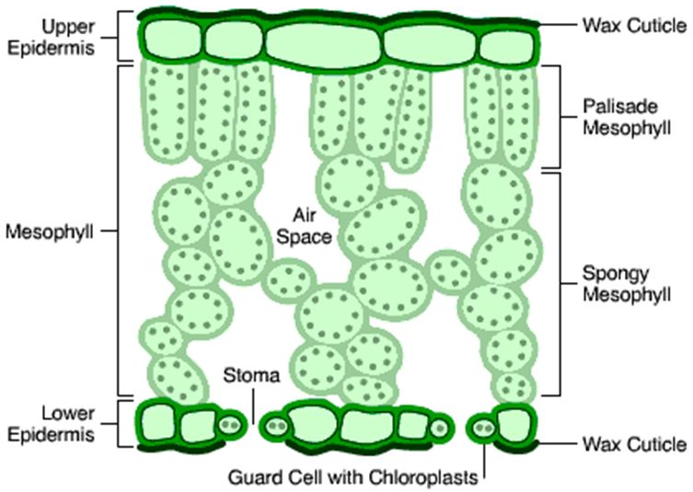
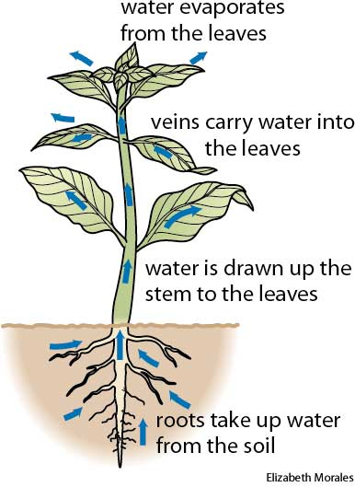
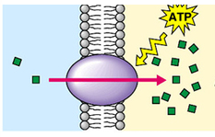
Plant Systems Knowledge Organiser
Active transport | Movement of particles against a concentration gradient
Diffusion | Movement of particles from high concentration to low concentration
Organ | A group of different tissues working together to perform a particular function
Organ system | Group of organs working together to perform a function
Phloem | Tissue which transports dissolved sugars a plant
Tissue | Group of similar cells working together to perform a function
Translocation | Movement of dissolved sugars around a plant
Transpiration | Movement of water through a plant
Vascular bundle | Strand containing the xylem and phloem
Xylem | Tissue which transports water and minerals around the plant
Plants, like humans, are made of cells, tissues, organs and organ systems.
The Leaf
Epidermis | Transparent to allow sunlight to pass through
Palisade layer | Packed with chloroplasts to allow photosynthesis
Mesophyll layer | Air spaces to allow the diffusion of gases
Stoma | Gaps on the underside of the leaf to allow gases in and out of the leaf
Guard cells | Allow stomata to open and close
Translocation
Phloem transports dissolved sugars from the leaves to other parts of the plant in a process called translocation. Cell sap is able to flow from one phloem cell to the next through pores at the end of each wall.
Transpiration
Transport
Xylem and Phloem
Root hair cells absorb water by osmosis.
They absorb minerals by diffusion and active transport.
Plants absorb water through the roots. It is transported against gravity from roots to leaves. This is called transpiration. Plants are constantly losing water as vapour through the leaves.
Xylem is made from hollow tubes made from cell walls of dead cells and strengthened by lignin.
Active transport works against the concentration gradient (from low to high) and requires energy.
Transpiration can be increased by:
Brighter light (increases photosynthesis)
Increased temperature (diffuse faster)
Increased air (windier so changes concentration gradient as water is blown away)
Decreased humidity (steeper concentration gradient)
Phloem is made of living cells elongated and stacked to form tubes.

