Slide 1
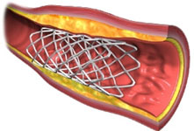
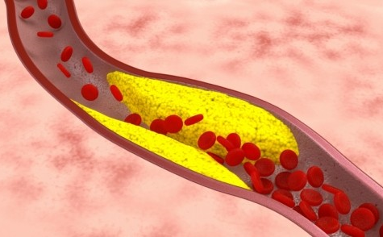
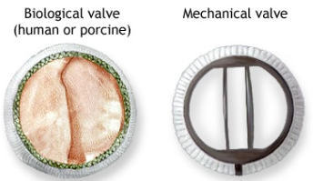
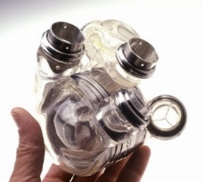
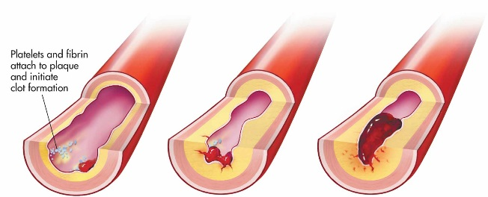
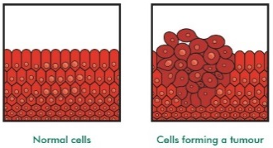
Non-Communicable Diseases Knowledge Organiser
Artery | Blood vessel that carries blood away from the heart.
Cancer | Non-communicable disease caused by uncontrolled cell division.
Non-communicable disease | Long term or slow progressing disease not caused by infectious pathogens.
Risk factor | Characteristic or exposure that increases the likelihood if developing a disease.
Statin | Chemical treatment for coronary heart disease taken to reduce cholesterol.
Stent | Physical treatment for coronary heart disease used to open up arteries.
Valve | Allow blood flow in correct direction and prevents backflow.
Some diseases are not caused by infectious pathogens. Non-communicable diseases are chronic diseases which can last for long periods of time and progress slowly.
Coronary Heart Disease
Fatty materials can build up in coronary arteries. This reduces blood flow to the heart muscle and a lack of oxygen to the cells. This can lead to a heart attack.
Stents can be used to keep the coronary arteries open.
Statins reduce cholesterol so the fat is deposited more slowly.
Faulty valves can be replaced with biological or mechanical valves.
If an artery gets blocked the blood flow is restricted. The blood pressure increases and damages the lining leading to a blood clot. This is called a thrombus.
Health and Lifestyle
The risk of developing coronary heart disease can be increased by several factors:
- Smoking
- High blood pressure
- High levels of salt
- High levels of saturated fat
Artificial hearts can used whilst a patient is waiting for a heart transplant.
Factors such as diet, stress and life situations can have a serious affect on health.
- Obesity can lead to diabetes
- Smoking can lead to lung disease
- Effect of smoking and alcohol on foetus.
- Alcohol can lead to liver disease
- Physical ill-health can lead to depression and mental illness.
Cancer
Cancer is an uncontrolled cell division. This results in a tumour.
Benign tumours grow until they have no more space but don’t usually cause any problems. That are not cancerous.
Malignant tumours grow and spread to neighbouring tissues. Bits can break off and move to other parts of the body. They are cancerous.

