Slide 1
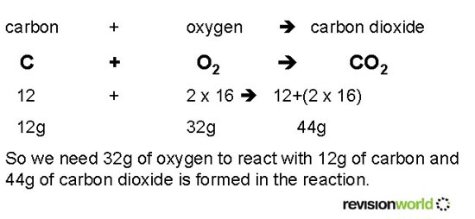
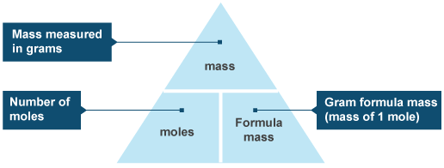
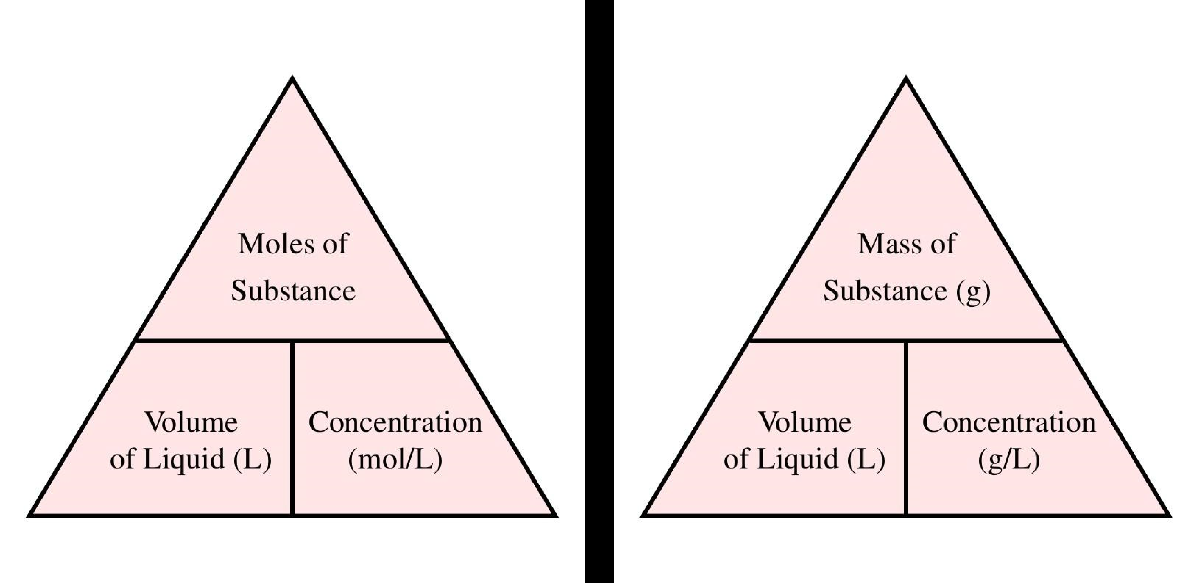
Key Terms
Knowledge Organiser – Quantitative Chemistry
Diagrams
Relative atomic mass | The average mass of atoms of an element, taking into account the mass and the amount of each isotope it contains.
Relative formula mass | The sum of the relative atomic masses of all the atoms in the formula.
Mole | Measurement of the amount of a substance.
Avogadro constant | The number of atoms, molecules or ions in one mole of a given substance (6.02x10²³).
Thermal decomposition | Reaction where high temperature causes a substance to break down into simpler substances.
Excess | When the amount of a reactant is greater than the mount that can react.
Limiting reactant | The reactant in a reaction that determines the amount of products formed. Any other reagents are all in excess and will not react.

