Slide 1
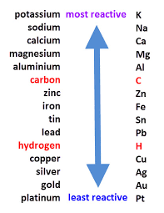
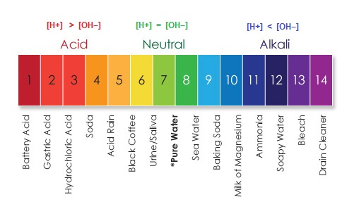
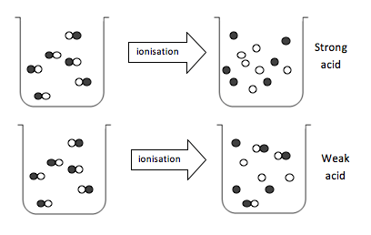
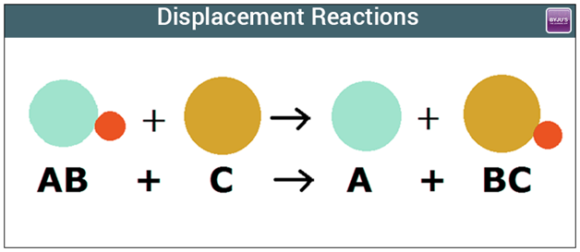
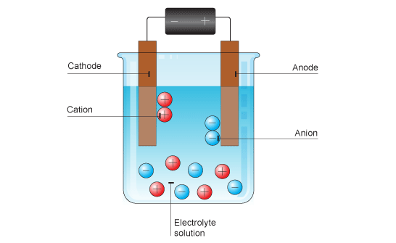
Key Terms
Knowledge Organiser – Chemical Changes
Diagrams
Reactivity series | An arrangement of metals in order of reactivity
Displacement reaction | Reaction where a more reactive element takes the place of a less reactive element in a compound
Oxidation | A reaction in which a substance loses electrons (gains oxygen)
Reduction | Reaction in which a substance gains electrons (loses oxygen)
Ore | A rock from which a metal can be extracted for profit
Acid | Solution with a pH less than 7; produces H⁺ ions in water
Alkali | Solution with a pH more than 7; produces OH⁻ ions in water
Aqueous | Dissolved in water
Strong acid | Acid in which all the molecules break into ions in water
Weak acid | Acid in which only a small fraction of the molecules break into ions in water
Dilute | A solution in which there is a small amount of solute dissolved
Concentrated | A solution in which there is a lot of solute dissolved
Neutralisation | A reaction that uses up some or all of the H⁺ ions from an acid
Electrolysis | Decomposition of ionic compounds using electricity
Electrolyte | A liquid that conducts electricity
Discharge | Gain or lose electrons to become electrically neutral
Inert electrodes | Electrodes that allow electrolysis to take place but do not react themselves
Acid + Alkali -> salt + water
Metal + acid -> salt + hydrogen
Metal oxide + acid -> salt + water
Metal carbonate + acid -> salt + water + carbon dioxide

