Slide 1
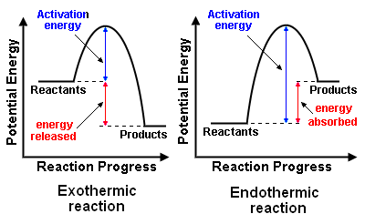
Knowledge Organiser – Energy Changes
Knowledge Organiser – Energy Changes
Exothermic reaction | Reaction where thermal energy is transferred from the chemicals to the surroundings and so the temperature increases
Endothermic reaction | Reaction where thermal energy is transferred from the surroundings to the chemicals and so the temperature decreases
Activation energy | The minimum energy particles must have to react
Exothermic reaction | Reaction where thermal energy is transferred from the chemicals to the surroundings and so the temperature increases
Endothermic reaction | Reaction where thermal energy is transferred from the surroundings to the chemicals and so the temperature decreases
Activation energy | The minimum energy particles must have to react

