Slide 1
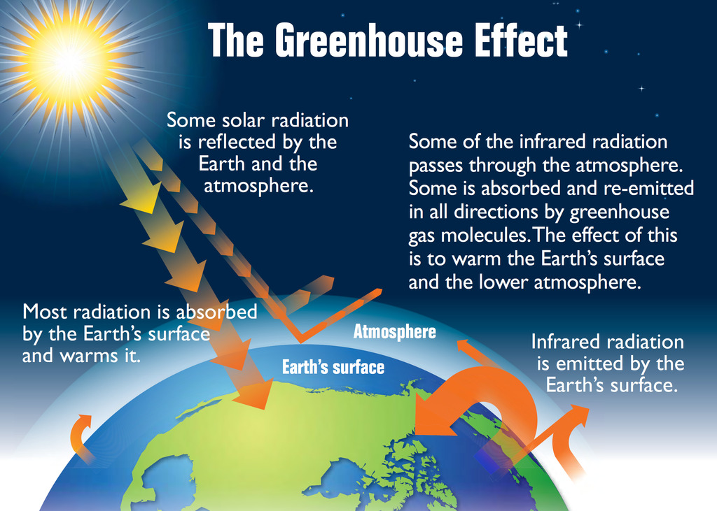
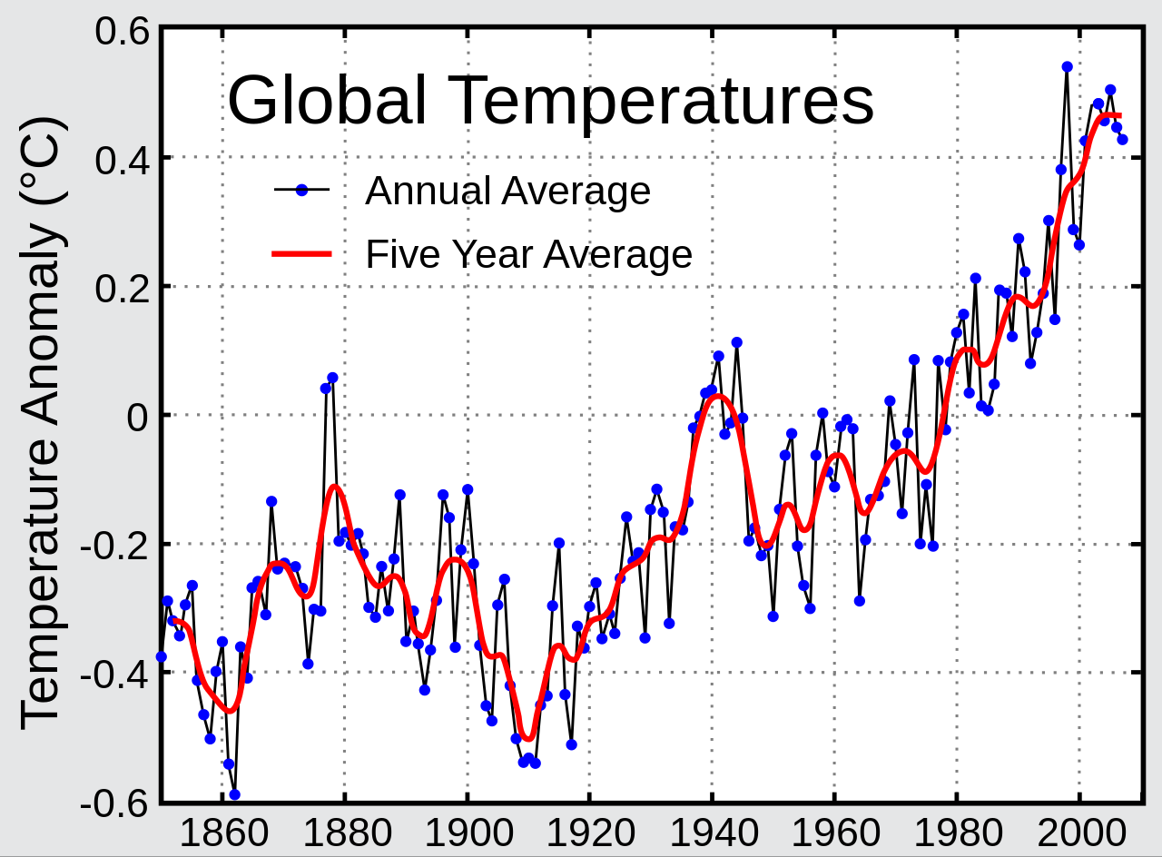
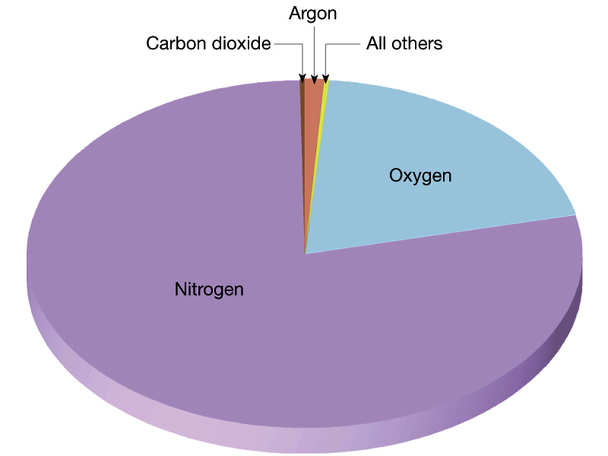
Key Terms
Knowledge Organiser – Chemistry of the Atmosphere
Diagrams
Greenhouse gas | A gas that absorbs long wavelength infrared radiation given off by the Earth but does not absorb the suns radiation.
Global warming | An increase in the temperature of the Earths surface.
Water stress | A shortage of fresh water.
Carbon footprint | The amount of carbon dioxide and other greenhouse gases given out over the full life cycle of a product, service or event.
Carbon neutral | Fuels and processes whose use results in zero net release of greenhouse gases to the atmosphere.

