Slide 1
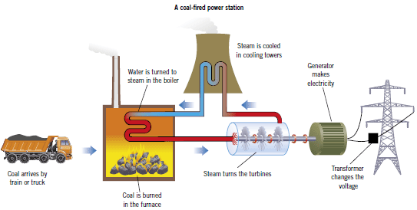
Key Terms
Knowledge Organiser – Energy
Diagrams
Specific heat capacity | The energy needed to raise the temperature of 1kg of a substance by 1°C.
Dissipate | To scatter in all directions or to use wastefully. When energy has been dissipated it means we cannot get it back. The energy has spread out and heats up the surroundings.
Non-renewable energy resources | Energy resources which will run out, because they are finite reserves, and which cannot be replenished.
Renewable energy resources | Energy resources which will never run out and (or can be) replenished as they are used.
Alternative energy resource | Resources other than fossil fuels. The resources may or may not be renewable. Nuclear power is not a renewable energy resource, but tidal power is. Alternative energy resources do not contribute to global warming.
Biofuel | Fuel produced from biological material. Biofuels are provided by trees such as willow that can be grown specifically as energy resources.
Energy Equations
Efficiency (%) = (useful energy out ÷ total energy in) x 100.
GPE = mgh Gravitational Potential Energy = mass x gravity x height.
E_{e} = ½ke² Elastic potential energy = 0.5 x spring constant x extension²
KE = ½mv² Kinetic Energy = 0·5 x mass x velocity².
W = F x d work done = force x distance.
W = E work done = energy transferred.
P = E ÷ t power = energy ÷ time.
E = c x m x θ energy = specific heat capacity x mass x change in temperature.

