Slide 1
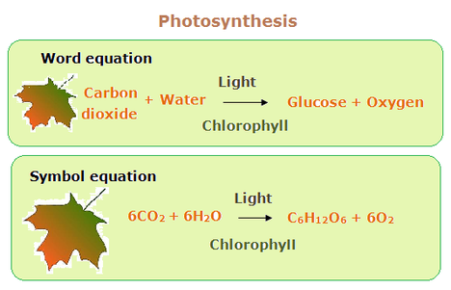
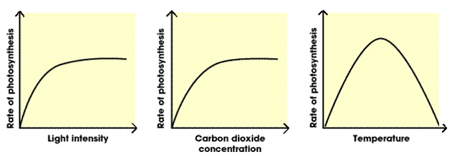
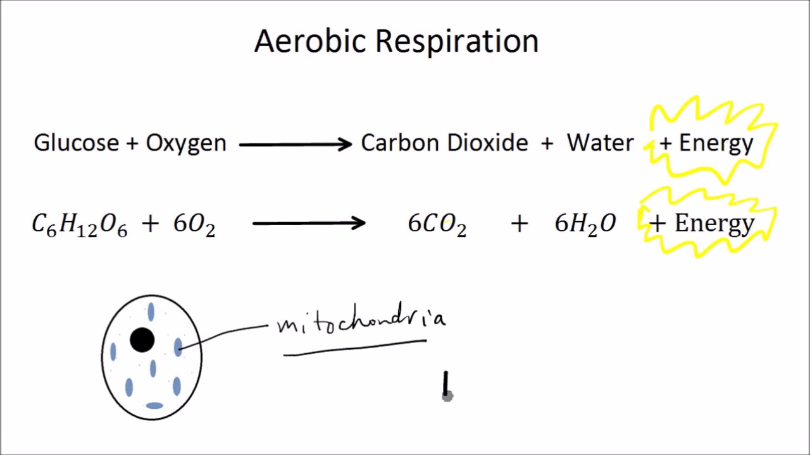
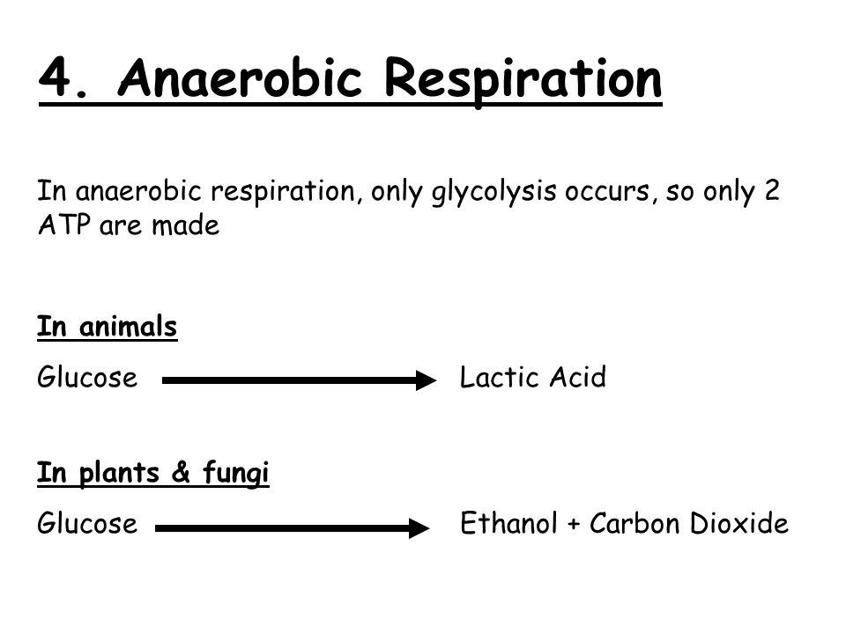
Key Terms
Knowledge Organiser – Bioenergetics
Diagrams
Endothermic reaction | A reaction that requires energy to be absorbed to work
Photosynthesis | The process by which plants use sunlight to produce glucose. Happens in chloroplasts
Limiting factor | Anything that reduces or stops the rate of a reaction
Yield | The amount of an agricultural product produced
Respiration | The process by which living things release energy from glucose. Happens in mitochondria
Aerobic | In the presence of oxygen
Oxidation | A reaction that uses oxygen
Exothermic reaction | A reaction that gives out thermal energy
Anaerobic | In the absence of oxygen
Oxygen debt | The amount of extra oxygen the body needs after exercise to break down lactic acid
Fermentation | The chemical breakdown of glucose into ethanol and carbon dioxide by respiring micro-organisms such as yeast
Metabolism | The sum of all the chemical reactions that happen in an organism
+ energy
+ energy

