Slide 1
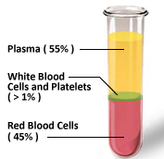
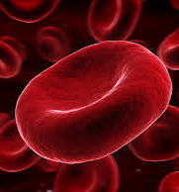
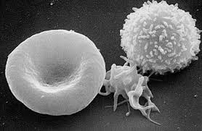
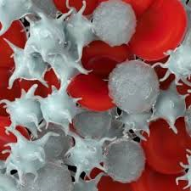
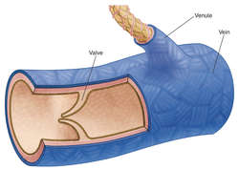
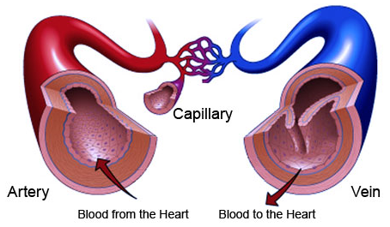
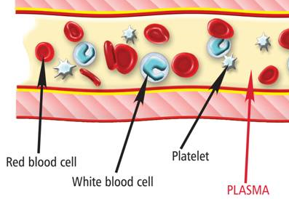
Blood Knowledge Organiser
Artery | Blood vessel that carries blood away from the heart.
Blood | A tissue consisting of red blood cells, white blood cells, plasma and platelets,
Blood vessel | How blood is transported around the body.
Capillary | Blood vessel that connects arteries and veins.
Plasma | Liquid in which other blood components are suspended,
Platelets | Cells that cause wounds to clot.
Red blood cells | Cells that carry oxygen around the body
Vein | Blood vessel that carries blood towards the heart.
White blood cells | Cells that fight microorganisms in the body
The Blood
The blood is a tissue.
It consists of four main components:
red blood cells
white blood cells
platelets
plasma
The cells components (mostly red blood cells) are suspended in the plasma meaning they are normally mixed evenly throughout the plasma.
Blood Vessels
Red Blood Cells
White Blood Cells
There are three types of blood vessel; arteries, veins and capillaries
These are disc shaped and biconcave. This increases their surface area. They can absorb and more oxygen. Red blood cells don’t have a nucleus to make more room for haemoglobin.
There are different types but they are part of the immune system and fight communicable disease. They all have large nuclei, and can also change shape so they can engulf microorganisms
Arteries
Veins
Capillaries
These carry blood at high pressure AWAY from the heart. They have a thick elastic wall
These carry blood at lower pressure back to the heart. They have a much thinner wall. They also contain valves to prevent backflow of the blood.
These are where exchange takes place so the wall are only one cell thick. They connect the arteries and the veins.
Plasma
Platelets
This makes up most of the blood. It is mostly made of water, but with substances like glucose, proteins, ions and carbon dioxide dissolved in it. The other components are suspended in the plasma.
Platelets are fragments of cells. Their function is to start the process of clotting at a wound. The clot blocks the injury until proper healing can happen, preventing excessive blood loss.

