Slide 1
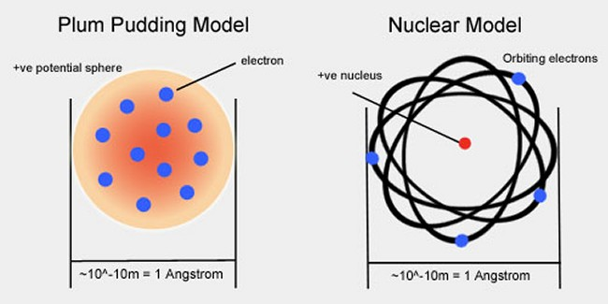
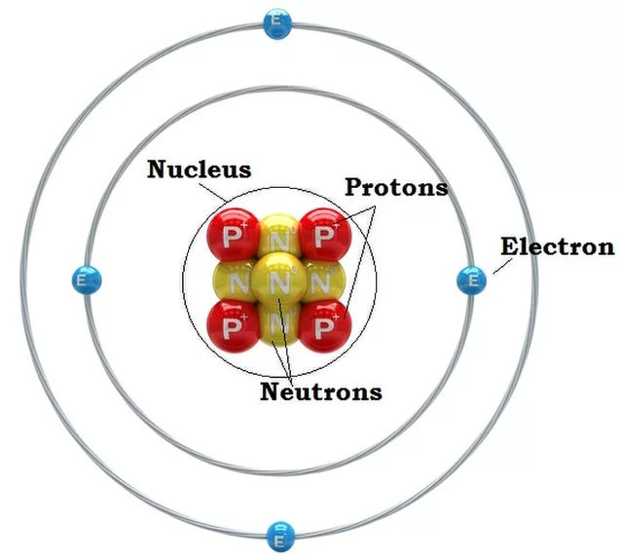
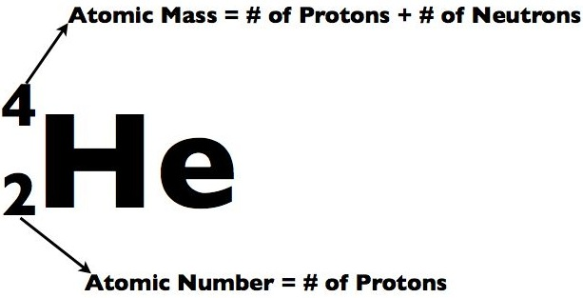
Key Terms
Knowledge Organiser – Atomic Structure and the Periodic Table
Diagrams
Atom | A particle with no electric charge made up of a nucleus containing protons and neutrons and surrounded by electrons.
Proton | A positively charged particle found in the nucleus of an atom.
Neutron | A neutral particle found in the nucleus of an atom.
Electron | Negatively charged particles found on energy levels (shells) surrounding the nucleus inside atoms.
Nucleus | Central part of an atom containing protons and neutrons.
Energy level (shell) | The region an electron occupies surrounding the nucleus inside an atom.
Atomic number | Number of protons in an atom.
Mass number | Number of protons plus neutrons in an atom.
Isotope | Atoms with the same number of protons but a different number of neutrons.
Relative atomic mass | The average mass of atoms of an element taking into account the mass and amount of each isotope it contains. RAM = Total mass of atoms / total number of atoms
Electronic structure | The arrangement of electrons in the energy levels of an atom.
Ion | An electrically charged particle containing different numbers of protons and electrons.
Group | The name given to each column in the periodic table.
Element | A substance containing only one type of atom.
Compound | A substance made from different elements chemically bonded together.
Period | The name given to a row in the periodic table.
Alkali metals | The elements in Group 1 of the periodic table.
Noble gases | The elements in Group 0 of the periodic table.
Halogens | The elements in Group 7 of the periodic table.
Diatomic molecule | A molecule containing 2 atoms.
Halides | Compounds made from Group 7 elements.
Mixture | More than one substance that are not chemically bonded.
Solvent | The liquid that a solute dissolves in.
Solution | A solute dissolved in a solvent.
Soluble | A substance that will dissolve.
Insoluble | A substance that will not dissolve.
Solute | The solid that dissolves in a solvent.

