Slide 1
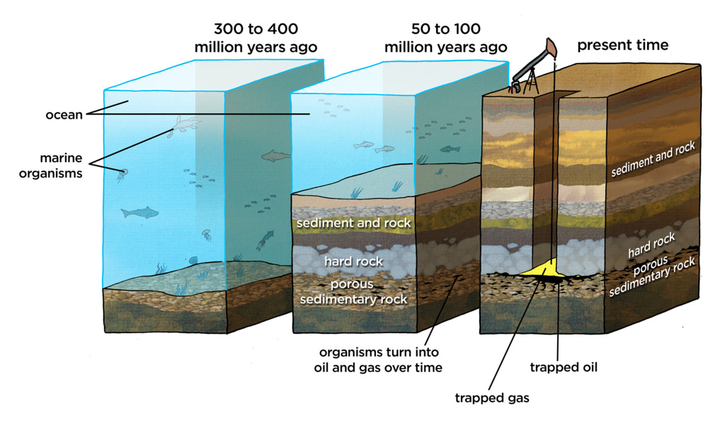
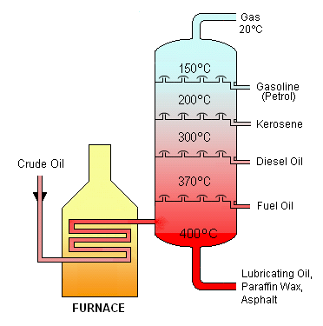
Key Terms
Knowledge Organiser – Hydrocarbons
Diagrams
Biomass | A resource made from living or recently living organisms.
Hydrocarbon | A compound containing hydrogen and oxygen only.
Alkanes | A homologous series of saturated hydrocarbons with the general formula C_{n}H_{2n+2.}
Saturated | A molecule that only contains single covalent bonds. It contains no double covalent bonds.
Displayed Formula | Drawing of a molecule showing all atoms and bonds.
Homologous Series | A family of compounds with the same general formula and similar chemical properties.
Fractional Distillation | A method used to separate miscible liquids with different boiling points.
Fraction | A mixture of molecules with similar boiling points.
Complete Combustion | When a substance burns with a good supply of oxygen.
Flammability | How easily a substance catches fire; the more flammable, the more easily it catches fire.
Viscosity | How easily a liquid flows; the higher the viscosity the less easily it flows.
Alkenes | A homologous series of unsaturated hydrocarbons with the general formula C_{n}H_{2n.}
Unsaturated | A molecule that contains one or more double covalent bonds.
Polymer | A long chain molecule in which lots of small molecules (monomers) are joined together.

