Slide 1
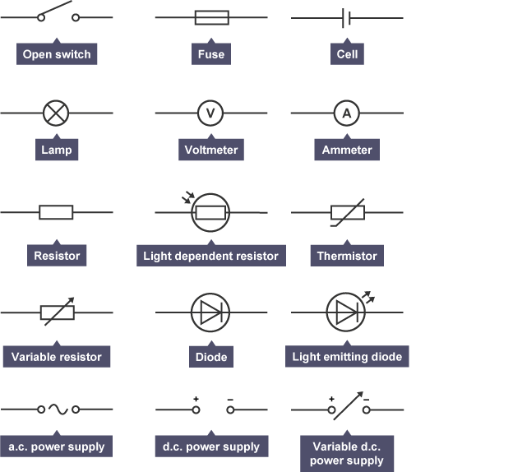
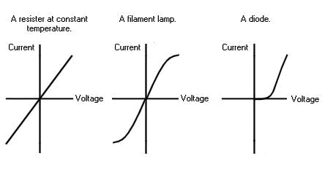
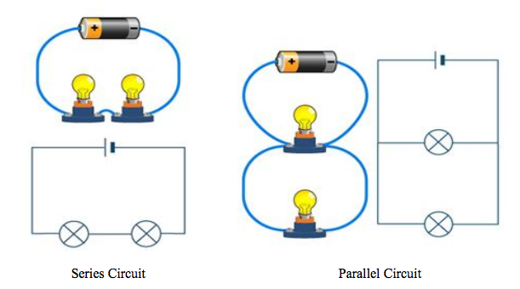
Key Terms
Knowledge Organiser – Electricity
Diagrams
Potential difference (p.d.) | A measure of the electrical work done by a cell (or other power supply) as charge flows round the circuit. Potential difference is measured in volts (V).
Electric current | A flow of electrical charge. The size of the electric current is the rate at which electrical charge flows round the circuit.
Resistor | A component that acts to limit the current in a circuit. When a resistor has a high resistance, the current is low.
Directly proportional | When two quantities are directly proportional, doubling one quantity will cause the other quantity will cause the other quantity to double. When a graph is plotted, the graph line will be straight and pass through the origin.
Inversely proportional | When two quantities are inversely proportional, doubling one quantity will cause the other quantity to halve
Ohmic | The current flowing through an ohmic conductor is proportional to the potential difference across it. If the p.d. doubles, the current doubles. The resistance stays the same.
Non-ohmic | The current flowing through a non-ohmic resistor is not proportional to the potential difference across it. The resistance changes as the current flowing through it changes.
P = V x I power = voltage x current.
V = I x R voltage = current x resistance.
Q = I x t charge = current x time.
E = V x Q energy = voltage x charge.
E = V x I x t energy = voltage x current x time.
Total cost = number of units x cost per unit.

