Slide 1
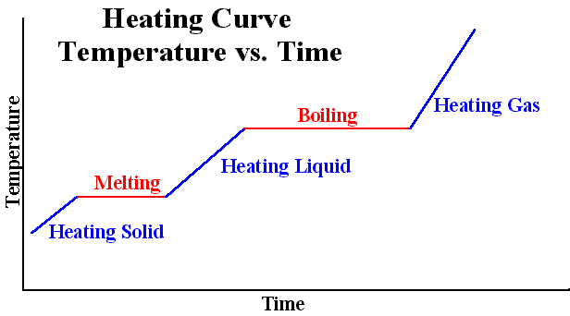
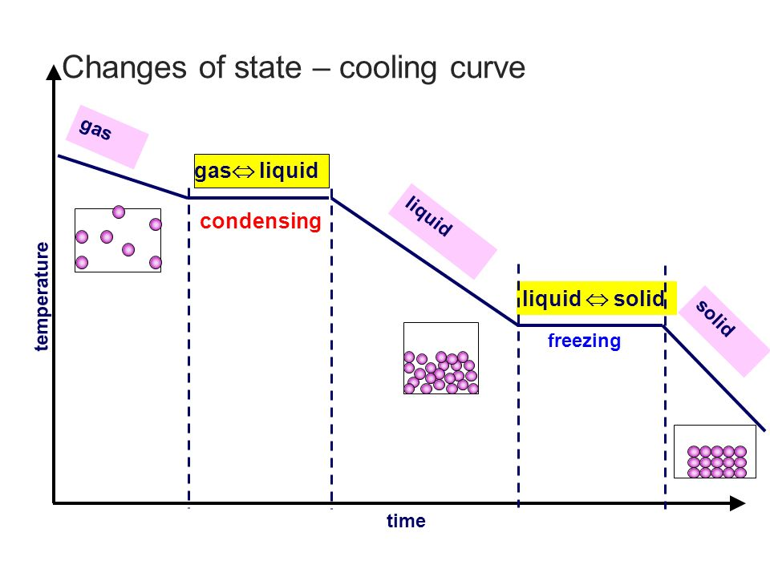
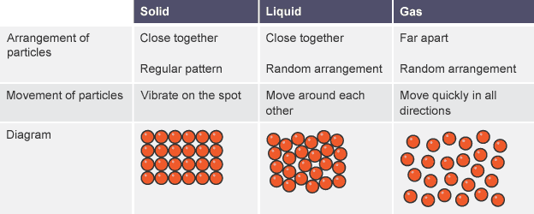
Key Terms
Knowledge Organiser – Particle Model of Matter
Diagrams
Equations
ρ = m/v Density = Mass ÷ volume
ΔE = mc Δθ Change in thermal energy = mass x specific heat capacity x temperature change
E = mL Energy required to change state = mass x specific latent heat

