Slide 1
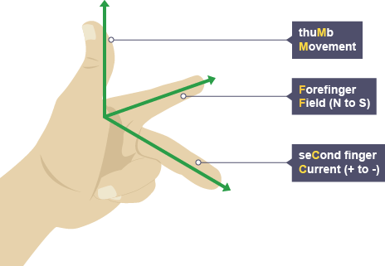
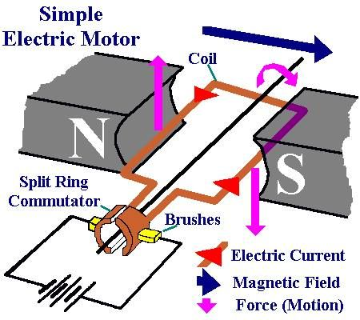
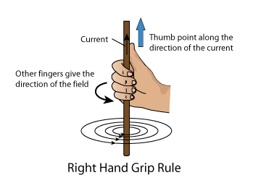
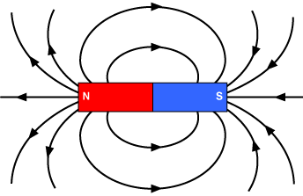
Key Terms
Knowledge Organiser – Magnetism and Electromagnetism
Diagrams
Magnetic | Materials that are attracted by a magnet.
North-seeking pole | The end of the magnet that points north.
South-seeking pole | The end of the magnet that points south.
Permanent magnet | A magnet which produces its own magnetic field. It always has a north and a south pole.
Induced magnet | A magnet which becomes magnetic when it is placed in a magnetic field.
Right-hand grip rule | A way to work out the direction of the magnetic field in a current-carrying wire if you know the direction of the current.
Solenoid | A solenoid is a long coil of wire.
Flux density | The number of lines of magnetic flux in a given area. F=B x I x L Force = magnetic flux density x current x length
Motor effect | The force produced between a conductor carrying a current within a magnetic field and the magnet producing the field.

